Slide 1
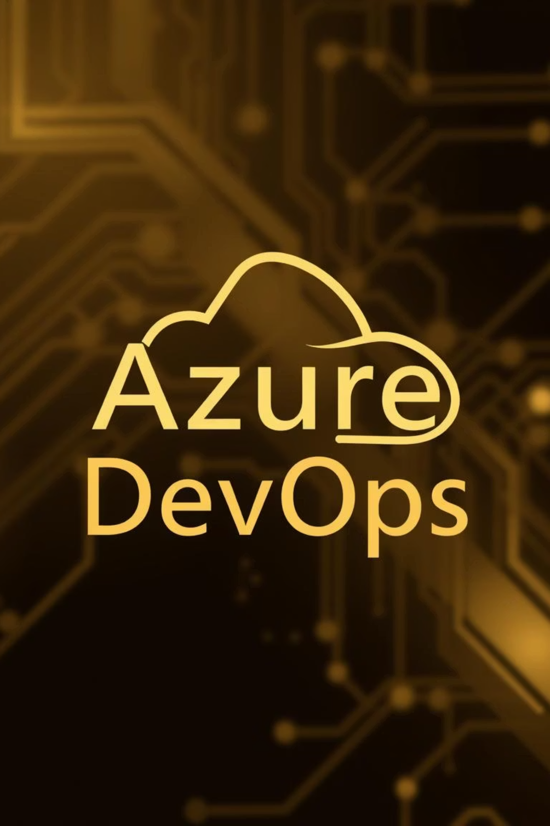

Real-World Automation in Azure DevOps
Bringing Efficiency & Scale Through Smart Workflows
Presented by Avaneesh | DevOps Engineer

Slide 2

What Do We Mean by “Automation”?
In DevOps, automation refers to using tools and scripts to perform repetitive tasks, eliminating manual effort and human error. Think of it as a reliable robot for your software development lifecycle.
Imagine deploying code manually every day – slow, error-prone, and frustrating!
Automation provides speed, consistency, reliability, and auditability.
💡 Real-Life Comparison: Automating software deployment is like using a self-driving car instead of navigating manually in heavy traffic. It's faster, safer, and more efficient!

Slide 3



Types of Automation in Azure DevOps (Part 1)
CI/CD Pipelines
Infrastructure Automation
QA/Test Automation
Automate the journey from Code commit to Deployment, ensuring rapid and consistent software delivery.
Manage and provision infrastructure as code (IaC) using tools like Bicep or Terraform for consistent environments.
Automate unit, integration, and load tests to catch bugs early and ensure software quality.

Slide 4
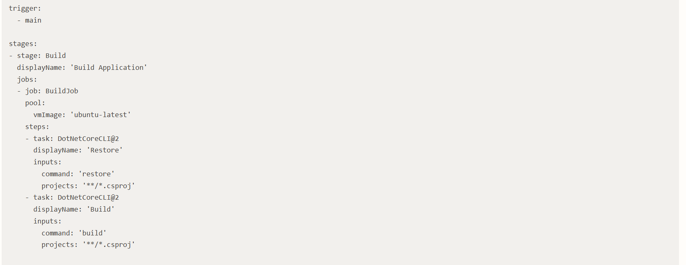
Automation in Pipelines (YAML Style)
YAML pipelines are the heart of automation in Azure DevOps, defining your CI/CD flow as code.
trigger: - mainstages:- stage: Build displayName: 'Build Application' jobs: - job: BuildJob pool: vmImage: 'ubuntu-latest' steps: - task: DotNetCoreCLI@2 displayName: 'Restore' inputs: command: 'restore' projects: '**/*.csproj' - task: DotNetCoreCLI@2 displayName: 'Build' inputs: command: 'build' projects: '**/*.csproj'
Trigger: Defines when the pipeline runs (e.g., code push to main branch).
Stages: High-level logical divisions (e.g., Build, Test, Deploy).
Jobs: Collections of steps that run together on an agent (e.g., BuildJob).
Tasks: Individual automation units (e.g., DotNetCoreCLI@2 for .NET build).

Slide 5



Types of Automation in Azure DevOps (Part 2)
Script-Based Automation
Monitoring & Auto-remediation
Boards/Repo Automation
Leverage Python, PowerShell, or Bash scripts within pipelines for custom tasks and integrations.
Set up Trigger-based automation to respond to alerts or conditions, initiating auto-healing workflows.
Automate work item movements, repository policies, and branch workflows using built-in rules.

Slide 6
Boards & Repo Automation
Automate workflows and enforce quality standards directly within your Boards and Repositories.
PR Validation Policies
Work Item Linking
Rules in Boards
Automatically run builds or tests on Pull Requests (PRs) before merging code.
Auto-move work items (e.g., tasks, bugs) based on branch creation or PR completion.
Define custom rules to automate field updates or assignees when work items change state.

Slide 7
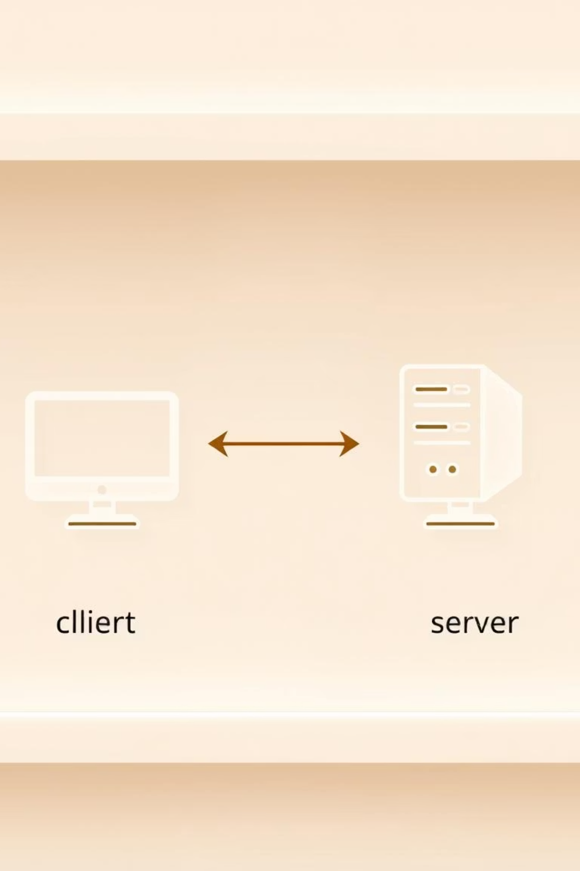
How APIs Fit Into Automation
At its core, automation relies on communication. REST APIs are the language of this communication.
Think of client-server architecture as a restaurant: the client (you) requests food from the server (kitchen).
Azure DevOps exposes REST endpoints, allowing external tools or scripts to interact with its services programmatically.
Accessing these APIs requires authentication, typically using a Personal Access Token (PAT) for secure access.

Slide 8
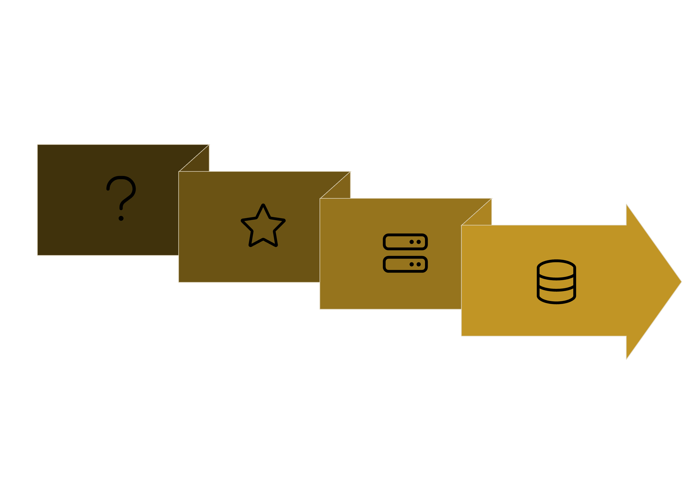



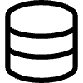
How APIs Request Work
REST APIs are the backbone of modern automation, allowing different software systems to communicate and interact.
API Gateway
Database Response
Client Request
Backend Server
Client-Server Architecture: Your script acts as a "client" requesting actions from the Azure DevOps "server" via REST API endpoints.
PAT Authentication: Use Personal Access Tokens (PAT) to securely authenticate your API calls, granting specific permissions.

Slide 9





Common API Automation Scenarios
Create Work Item
Automate creation of bugs or tasks via script.
Trigger Pipeline
Initiate a Pipeline run with custom parameters.
Query Build Status
Retrieve real-time build and deployment status.
Update Pipeline Variables
Dynamically modify Pipeline variables during execution.
Auto-Close Tasks
Automatically mark tasks as complete post-deployment.

Slide 10
Azure DevOps REST APIs – Essentials
Understanding the basic structure is key to using Azure DevOps REST APIs effectively.
API Structure: Base URL (e.g., dev.azure.com/{organization}) + Endpoint (e.g., _apis/build/builds) + Method (GET, POST, etc.) + Authentication (PAT).
Work Items: Create, update, query tasks, bugs, features.
Postman: For testing and exploring API endpoints.
Pipelines: Trigger builds, manage definitions.
Python requests: For scripting complex automation.
Builds/Releases: Get status, manage deployments.
PowerShell: For scripting within Azure or on-prem environments.
Azure DevOps REST API Documentation

Slide 11
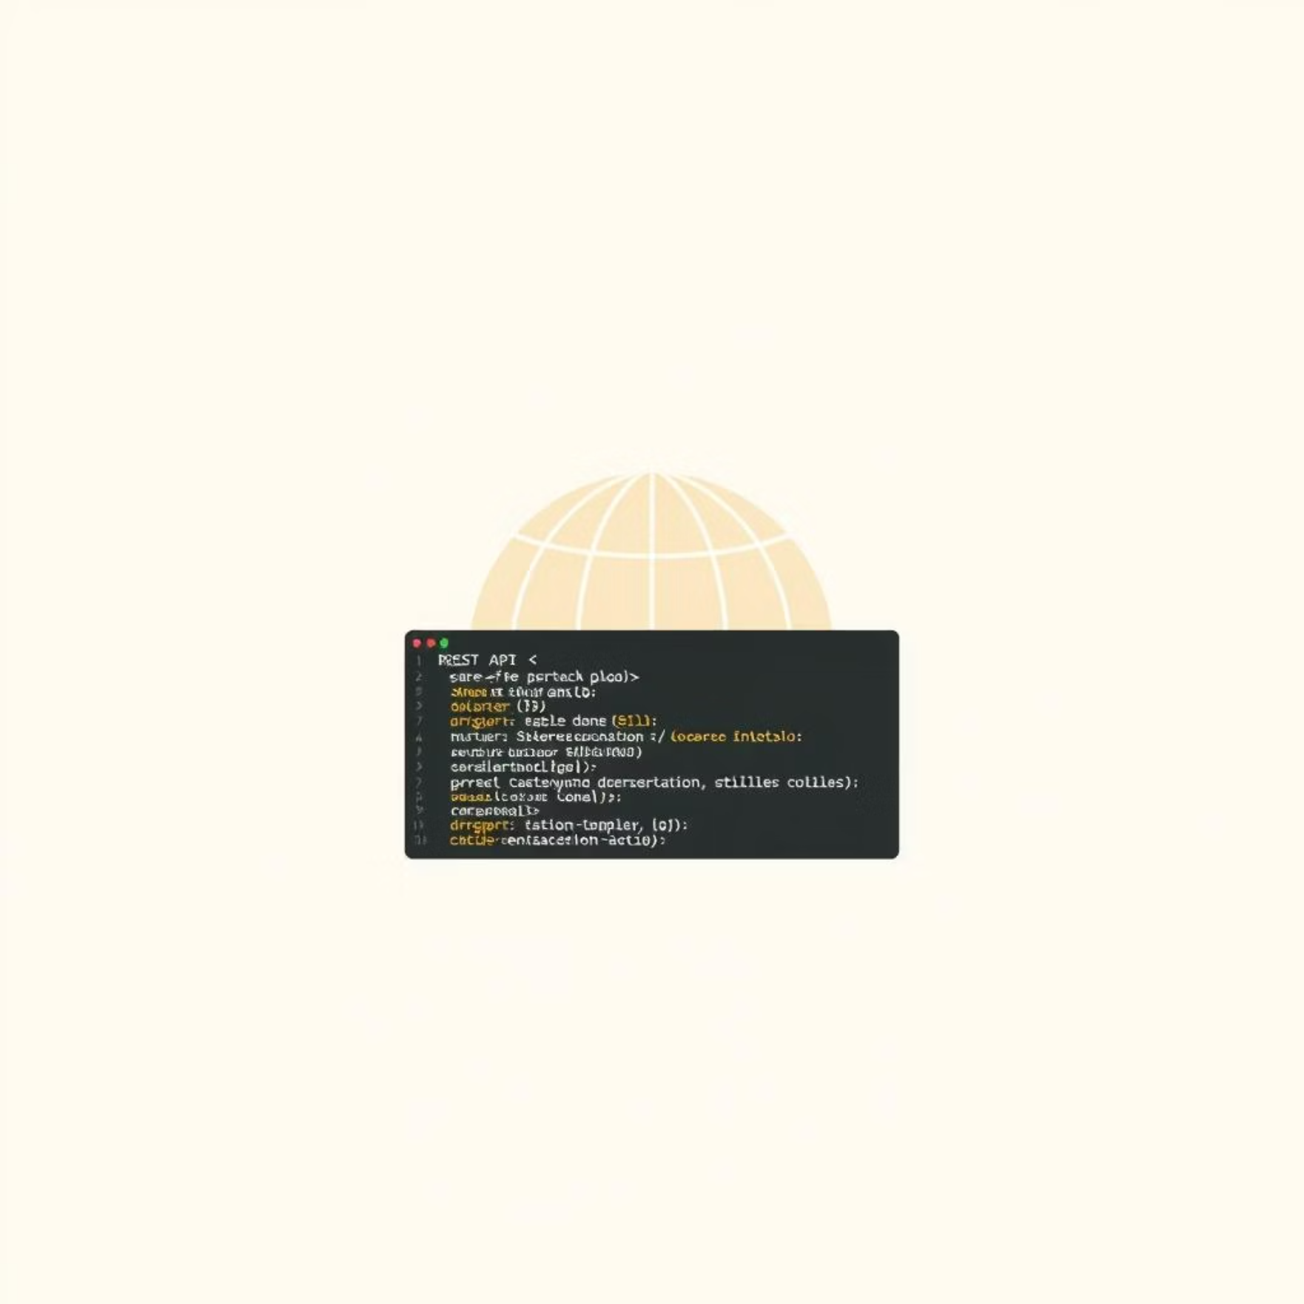

Azure DevOps REST APIs – Essentials
Base URL: https://dev.azure.com/{organization}/{project}/_apis
Endpoint: Specific resource, e.g., /wit/workitems/{id}
Method: GET, POST, PUT, DELETE (HTTP verbs)
Auth: Personal Access Token (PAT) in header
Key APIs:
Work Items
Pipelines & Builds
Releases
https://learn.microsoft.com/en-us/rest/api/azure/devops/?view=azure-devops-rest-7.2
Tools Used:
Postman
Python requests library
PowerShell Invoke-RestMethod
Explore the official docs: Azure DevOps REST Docs

Slide 12



Demo Time – Watch Automation in Action!
Let's see these automation concepts come to life with some practical examples.
API Call to Create Work Item
Trigger Pipeline via Script
Auto-Close Work Item

Slide 13

Summary & Key Takeaways
Start Small: Automate incrementally, one task at a time.
Pipelines as Code: Use YAML Pipelines for version control and maintainability.
REST APIs: Your powerful enabler for cross-tool automation.
Learn More: Explore official Azure DevOps documentation and community resources.
Thank You! Any Questions?

